Slide 1

Linux Basics
副标题

Slide 2
TENET
Use Google, in English (stack Overflow, github, cppreference)
Build The Semantic Tree: Crash (home page)+ CSAPP (pdf)
Mindset: Fast Learning
Hierarchy: Decomposition, Abstract → Efficiency!

Slide 3
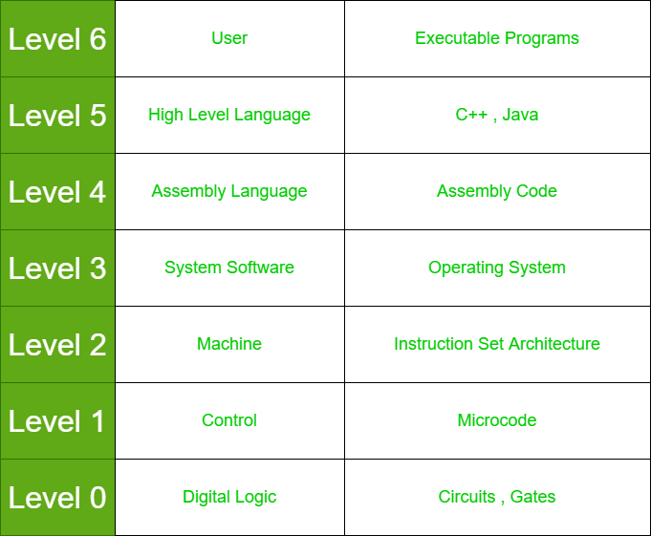
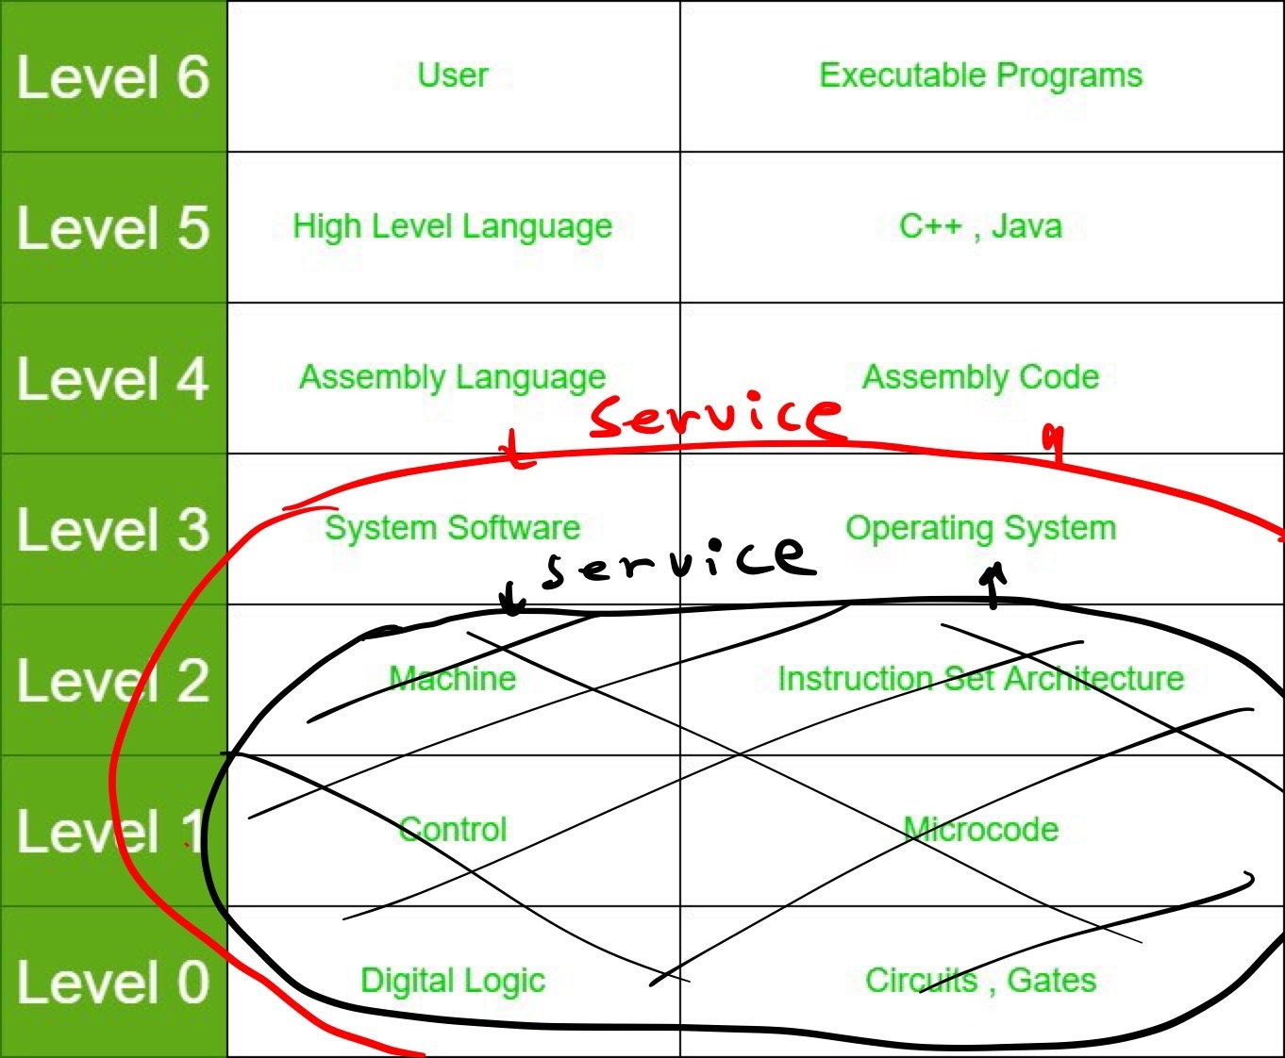
Linux – An Operating System
Abstraction ——＞

Slide 4
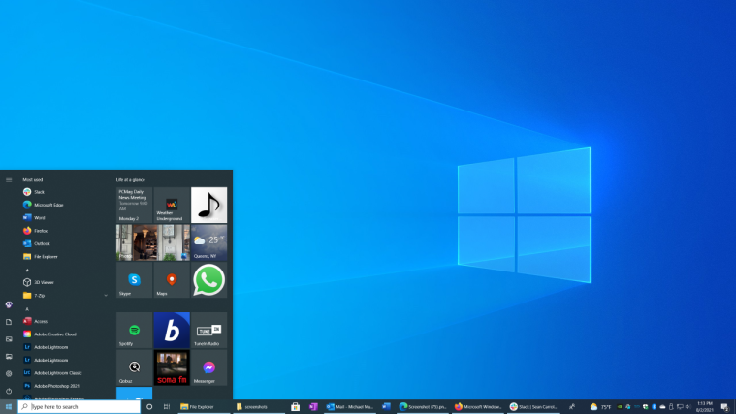

Stereotype
OS: Windows
This is the content of the computer
Computer: Laptop
This is the computer

Slide 5
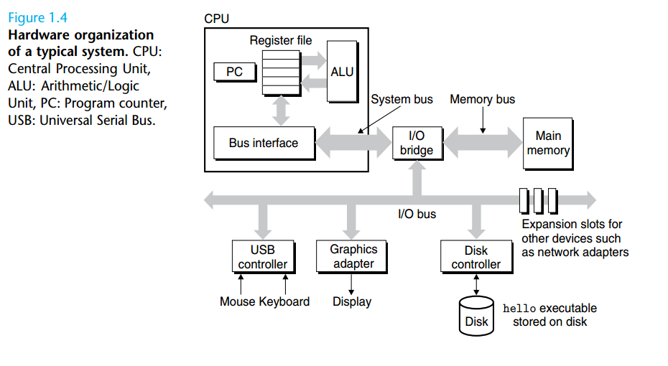
The Graph

Slide 6
What happens when we press the start button?
System booting
OS: the first running program
GUI vs CLI
What happens when we run a program?
File system
loader
Main Memory
CPU

Slide 7
Start to use Linux
VM
Duel Boot
SSH (make a demo)

Slide 8
Command Line
Google, error prompt
MAN, -help
MIT The Missing Lecture (youtube page)
Linux Tutorial

Slide 9
Command Line
Sudo (superuse)
Cd (directory)
Vim (editor)
htop

Slide 10
Common Mistakes (By Levi)
Sudo
Current Directory
Some Blank

Slide 11

Git and Github
Compilation:
GNU GCC
Make
CMake
Vim(Neovim)
Debugger:
vscode extensions
gdb
valgrind

